Slide 1
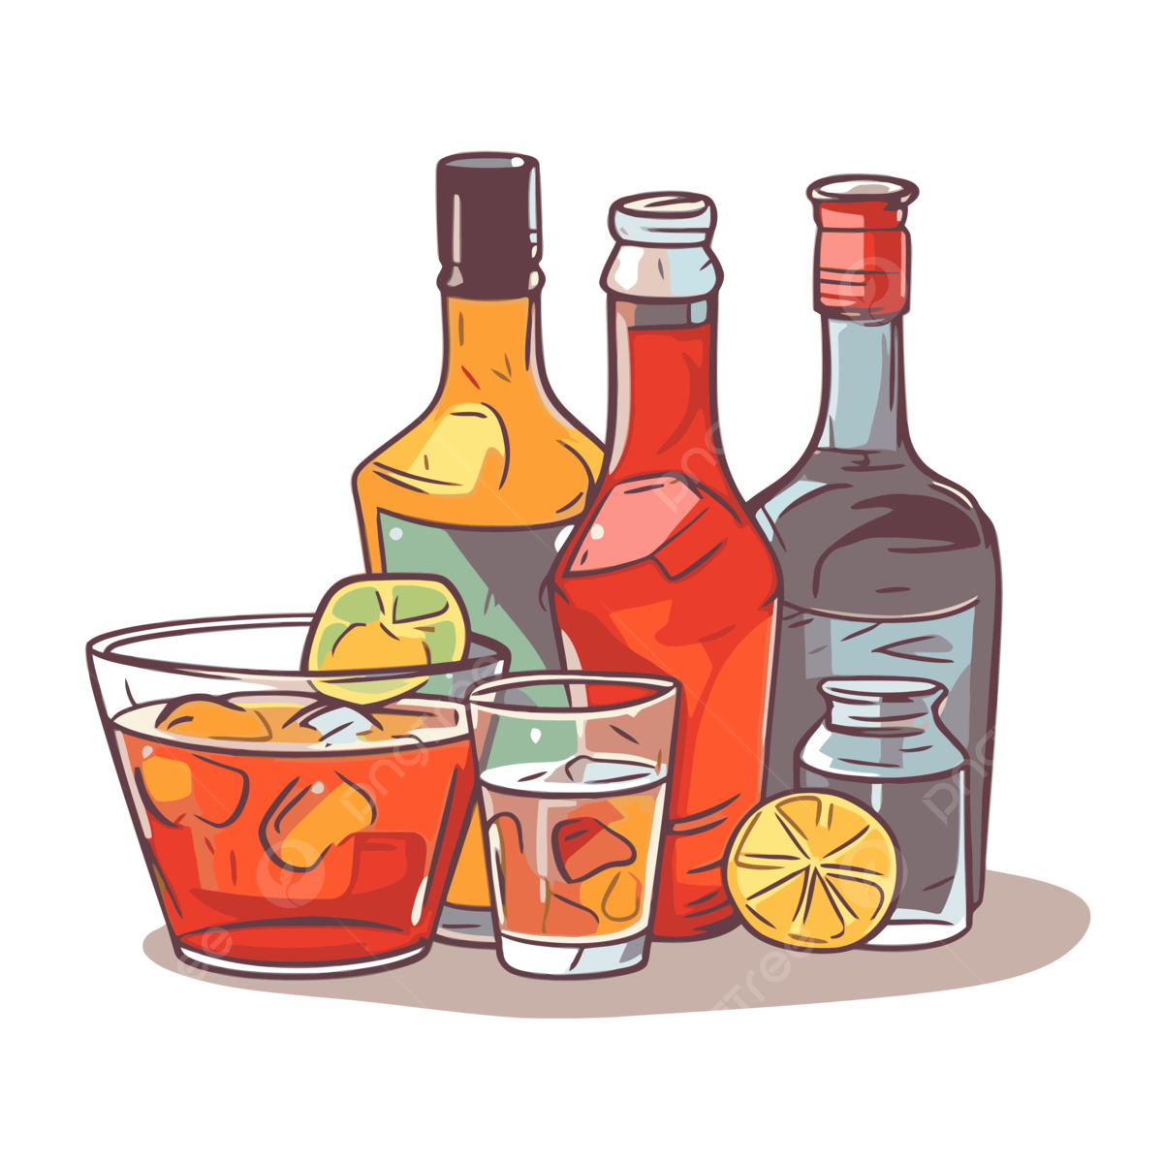
Booze or No Drink Smart, Stay Safe
Paniz Ziaie, Paya Karimi, Franziska Wojtkowski and Ali Badran
Notes:
Imagine this: you’re out with friends, ready to enjoy a drink, when you suddenly remember—you took medication earlier today. Can you still have that beer? Or will it mess with your meds? That’s where “Booze or no?” comes in.

Slide 2
Our Vision
Smart & User-friendly Webapp
Medication
Diseases
Type and amount of alcohol
Making informed and responsible choices
Notes:
Our vision is to create a smart, user-friendly web app that helps people—starting with students—make informed and responsible choices when mixing alcohol with medication. Whether you’re on a prescription or just took some ibuprofen for a headache, our tool will let you know if it’s safe to drink, what kind of alcohol (beer, wine, or liquor) might be more risky, and—if needed—how long you should wait before drinking.

Slide 3
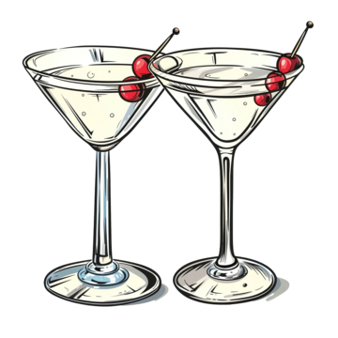
Our Vision
We believe that harm reduction starts with access to clear, personalized information. With “Booz or no?”, we’re offering a bridge between medical data and everyday life—not to encourage drinking, but to empower better decisions.
Notes:
Our vision is to create a smart, user-friendly web app that helps people—starting with students—make informed and responsible choices when mixing alcohol with medication. Whether you’re on a prescription or just took some ibuprofen for a headache, our tool will let you know if it’s safe to drink, what kind of alcohol (beer, wine, or liquor) might be more risky, and—if needed—how long you should wait before drinking.

Slide 4
What we’re building
01
Enter data
The medication they’ve taken or a disease they have
A web-based application
02
Choose alcohol
Choose the type of alcohol they are considering
03
Response
Booze or no?
Notes:
We’re developing a web-based application, hosted on a platform like Render, that connects users with accurate, up-to-date data from the an API. Users will simply:
Enter the medication they’ve taken,
Choose the type of alcohol they’re considering,
And get a clear response: “Booze or no?”—with an explanation and suggested waiting time if needed.
This real-time feedback can help prevent dangerous interactions, reduce hospital visits, and raise awareness about medication safety in casual drinking scenarios.

Slide 5
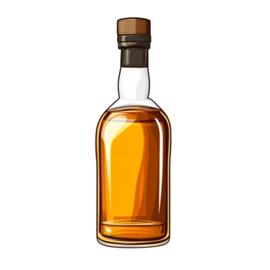
Why now?
There’s a growing awareness around personal health, and yet, very few people actually know how alcohol interacts with medications. This information exists, but it’s scattered, full of jargon, or buried in long PDF leaflets. We want to surface that data in a clear, accessible, and even slightly fun way without compromising accuracy or responsibility.

Slide 6
Our goals
Launch a functional, intuitive MVP web app
Set up a framework for later expansion to mobile and more languages
This course
Testing
Longterm
Test user feedback and iterate the UI for better clarity and engagement

Slide 7
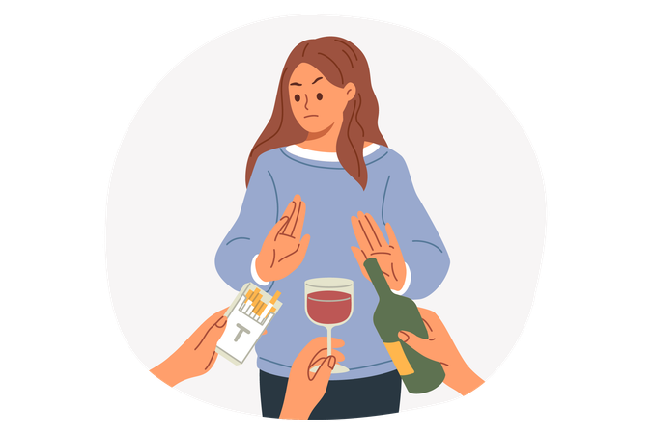
“Booz or no?” isn’t just an app—it’s a tool for awareness.
Notes:
We’re taking a serious health concern and giving users a simple, accessible way to avoid risky decisions. With the right mix of technology, medical data, and responsible design, we believe this project can actually make a difference—not just for students, but for anyone who ever asks, “Can I have a drink?”

Slide 8
Thank you!

